Slide 1
Unit Testing
Steven Kha
CPSC 463 Software Testing
Dr Ning Chen
25 February, 2018

Slide 2




What unit testing tool is being demonstrated?

Slide 3
What is a unit test?
Why do it?
Test small pieces of code
Check if it works
Fits design specification

Slide 4
Generally Unit Testing Procedure
Testing small pieces of code
Classes
Functions
Data Members

Slide 5
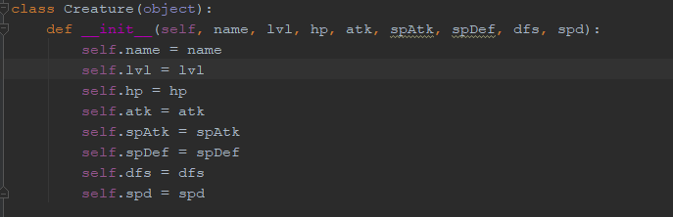
1st test case: Constructor
The source code of the constructor class

Slide 6
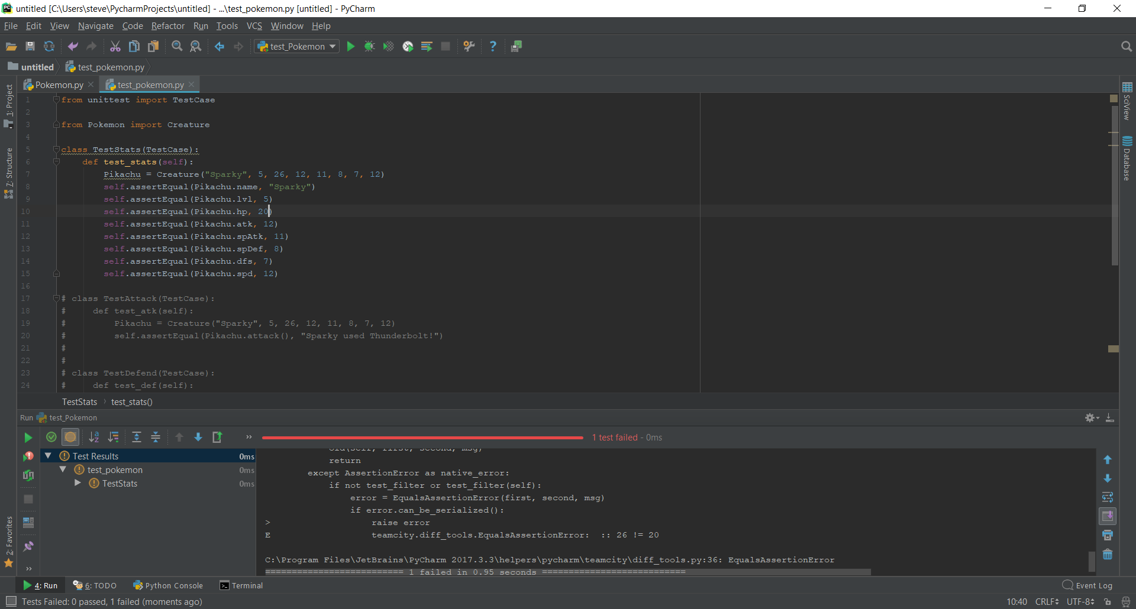
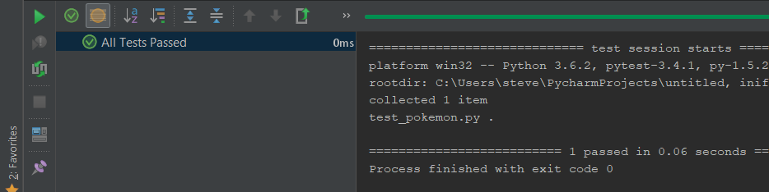
1st test case: Constructor
The test code of the constructor class
Error message
All test passed

Slide 7
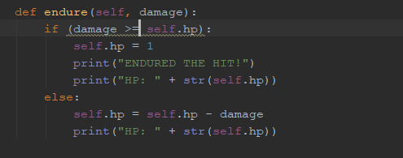
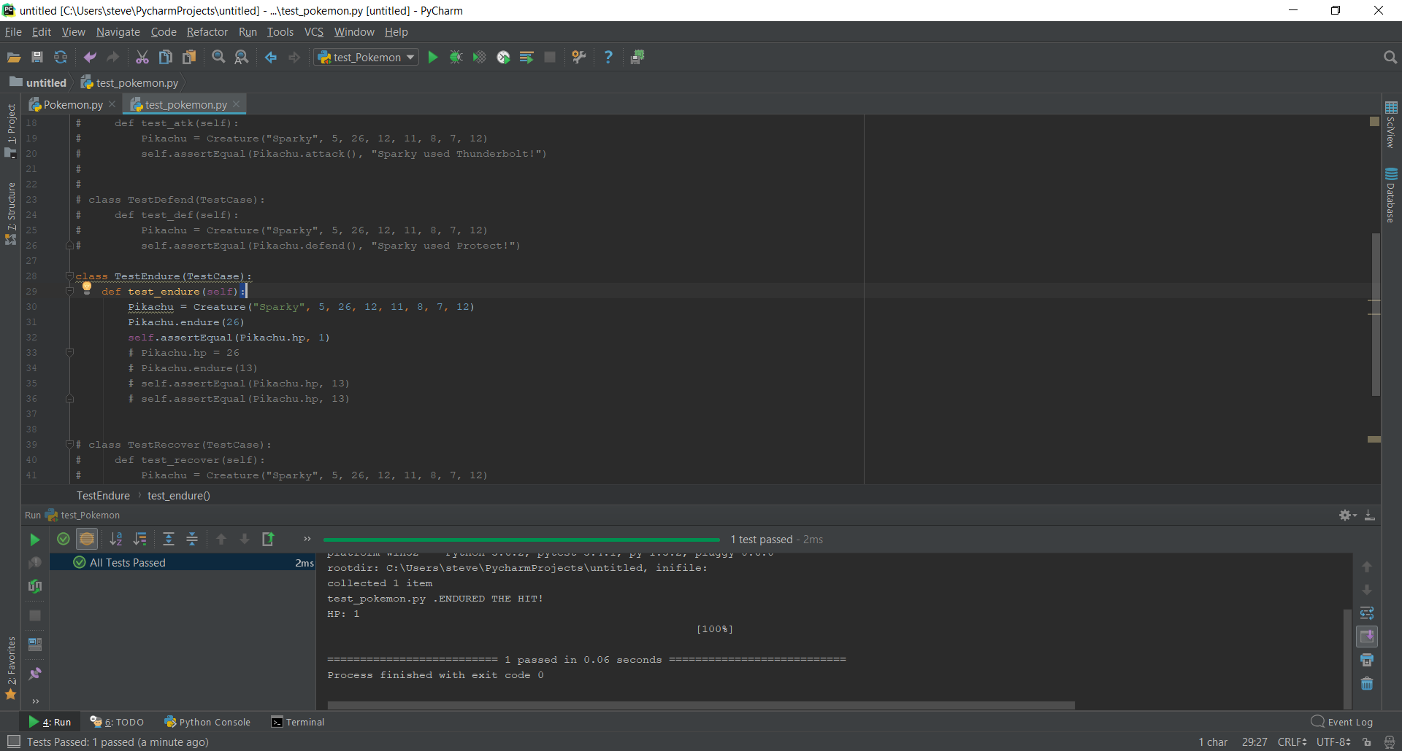
2nd test case: Integer Returning function
Function in source code →
Function in test file →
Success message →
Also notice the print
out message

Slide 8
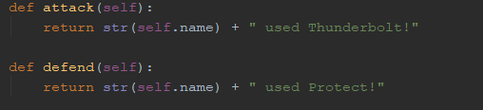
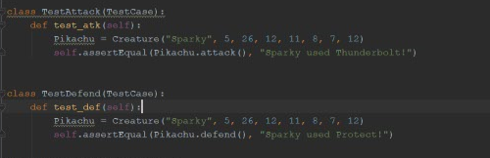
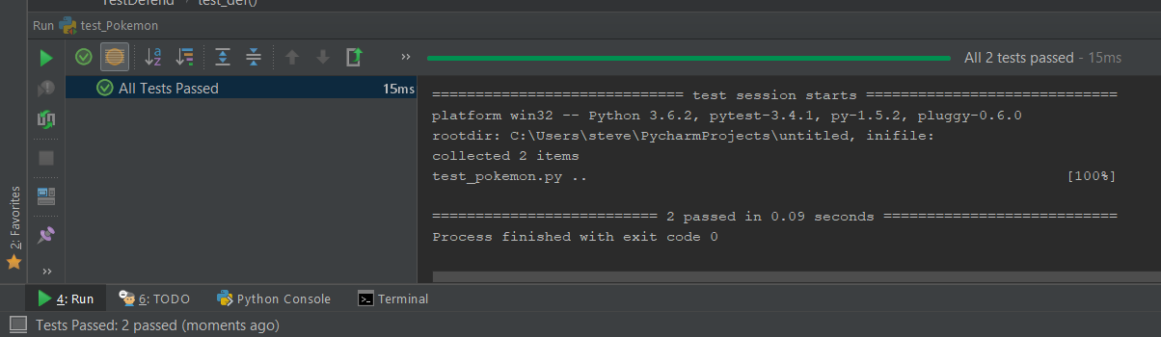
3rd and 4th test case: String Returning Function
Function in source code →
Function in test file →
Success message →

Slide 9
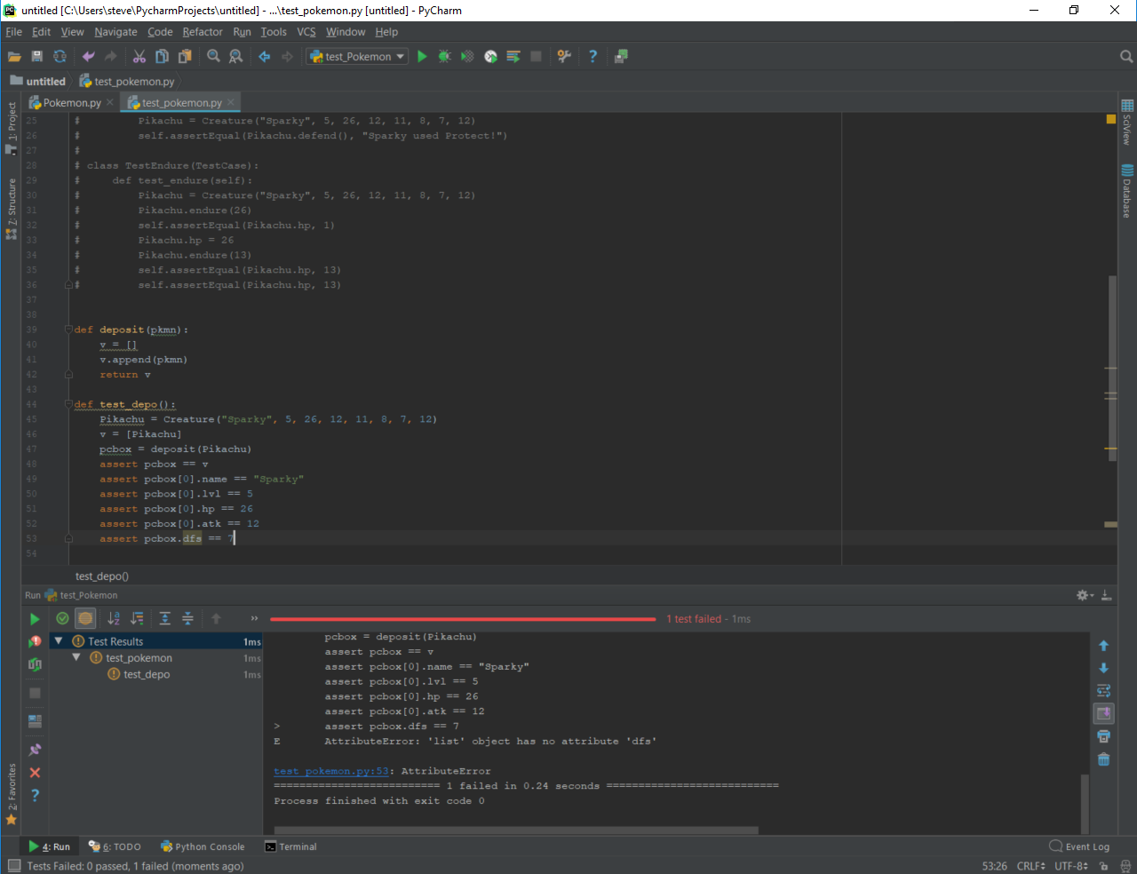
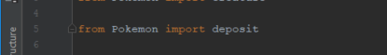
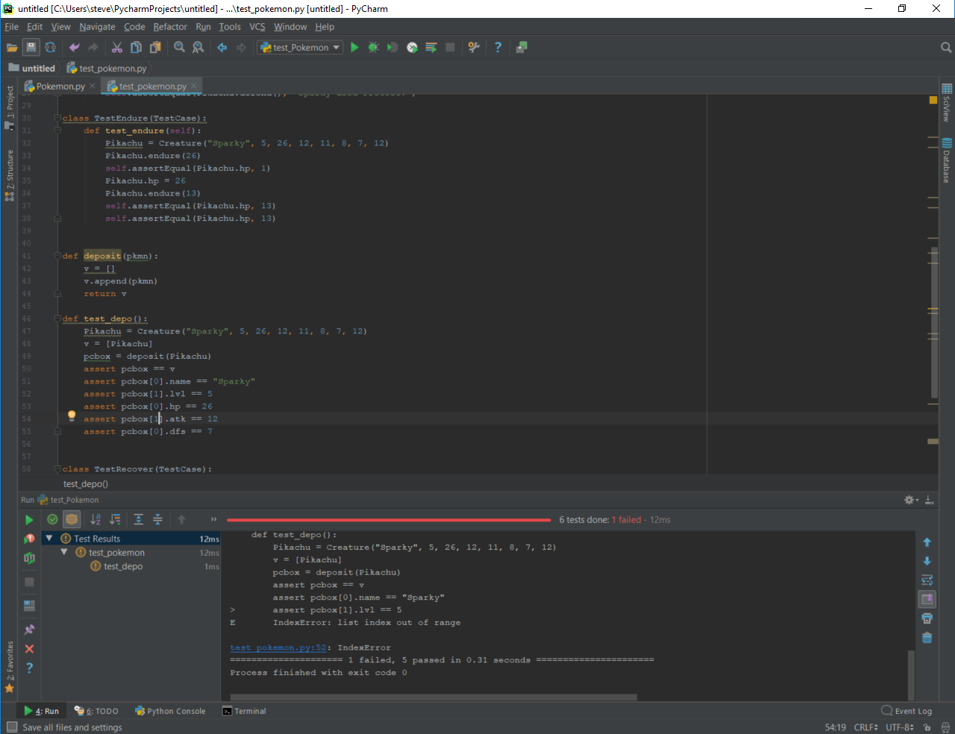
5th test case: Lone Function
Reading the error messages
Function definition in test case
Importing function
Only one error message at a time
Testing
The
code

Slide 10
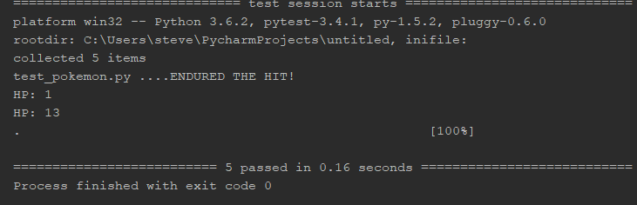
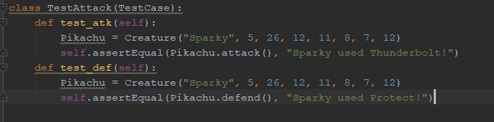
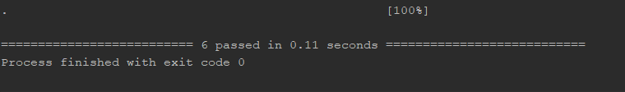
Test passed
All 5 test cases passed!
This counts as two test cases even in on test case class
And will increase it to 6
Test case passed

Slide 11
Conclusion
Pros
Cons
Overall…

Slide 12

Highly Recommend The End

